Slide 1
Performance Management
Session 7/10
Part II

Slide 2
Aims of performance management
Strategic
    The performance management system should communicate and reflect the company strategy in terms of expected employee results and behaviours, and skills to develop.
Administrative
  The performance management system is useful to make decisions regarding employee promotion/demotion, retention/termination, salary growth, etc.
  Developmental (main point)
    Feedback sessions are particularly important for employee development (analyse why employees are not performing; decide on training, job transfer, etc.)

Slide 3
A good Performance Appraisal system should be…
Focused
  What are the key relevant aspects to job performance?
  Fair
    Have people been given a change to participate in developing the system?
    Are people given detailed feedback?
    Are formal grievance mechanisms in place?
  Clear
    Do people understand the appraisal system?
    Do they know what dimensions of performance are being measured?
    Do people know what is expected of them?

Slide 4
3 Key decisions in designing a performance appraisal system
What to evaluate?
    Behaviour
    Results
    Employee attributes
  What performance benchmarks to use?
    Comparison with other employees
    Objective criteria
  Who to collect information from?
    Managers
    Peers
    Self
    Clients
    Others?
In practice companies use
combined approaches

Slide 5
What to Evaluate?

Slide 6
Evaluating behaviors
  Organizations identify the type of behaviors employees should exhibit to do their jobs effectively. Managers should then assess the extent to which employees exhibit these behaviors.
  Critical incidents
  Most methods focus on critical incidents, that is, on concrete behaviors that tipify examples of excellent/poor performance displayed by the employee and observed by the supervisor

Slide 7
How to do it?
  Behaviorally anchored rating scales (BARS)
  BARS identify a number of performance dimentions (e.g. Interaction with customers) and typify grades of performance levels corresponding to the exhibition of behaviors critical to success or failure on the job (e.g. 1-9). The rater should then grade employees according to the type of behavior that best describes their performance.

Slide 8

Example of a BARS
Teaching ability
1. Carefully read the dimension and supporting examples (in parentheses)
2. Read each performance level on this dimension for your ratee.
3. Consider the Typical performance level on this dimension for your ratee.
Compare his/her typical performance with each of the performance examples.
Circle the scale number (1-9) nearest to the performance example
9 | This instructor not only described concepts and process, but also the rationale supporting them.
8 | This instructor began each class period by asking students if they had any questions from the last class period, or This instructor taught several approaches to solving problems, pointing out rationale for each method.
7 | When new drug products entered the market, this instructor frequently used them in examples illustrating therapeutic aspects of the active ingredient(s).
6 | When lecturing from overhead projections, this instructor looked to the class, paused, asking if there were any questions.
5 | When overhead transparencies were removed before students could complete their notes, this instructor would say “You only need to listen to what I am saying.”
4 | This instructor used new scientific and professional terms freely, assuming that students already knew them.
3 | This instructor lectured “over the heads” of the level of intellect of the students.
2 | This instructor did not enunciate clearly, mumbling through lectures, or when students would ask this instructor to please repeat a point made in lecture, the instructor would say “Get it from your neighbor,” and continue lecturing.
1 | This instructor wrote notes on the chalkboard faster than students could comprehend and record them, then erased the notes before students completed taking them down.

Slide 9
Pros and Cons of the behavioral approach
PROS | CONS
Can be effective in linking the company strategy to specific behaviors that facilitate strategy implementation | Needs monitoring: as the company strategy changes employees are required to behave differently
Offers clear feedback to employees | Does not offer a clear link between employee performance and company performance
Contributes to employee development | Raters are prone to focus on ratees’ more recent behaviors (people tend to be on their best behavior by the time of the performance appraisal)

Slide 10
Evaluating attributes
Focuses on the extent to which individuals have certain characteristics or traits considered relevant for the company’s success
  Some of the attributes usually used are:
  Communication skills;
  Managerial skills;
  Interpersonal skills;
  Problem solving skills.

Slide 11
How to do it?
Graphic Rating Scales
It is the oldest and most widely used method of performance appraisal
A number of attributes are selected based on their importance for the organization
The scales may specify a number of points (usually 5) to rate performance – from 1 (poor performance) to 5 (excellent performance).
The manager rates the employees’ performance in each attribute
  Example:
  Dependability. Is conscientious with respect to attendance, relief and lunch breaks.
  Cooperation . Willingness and ability to work with others to produce desired goals.

Slide 12
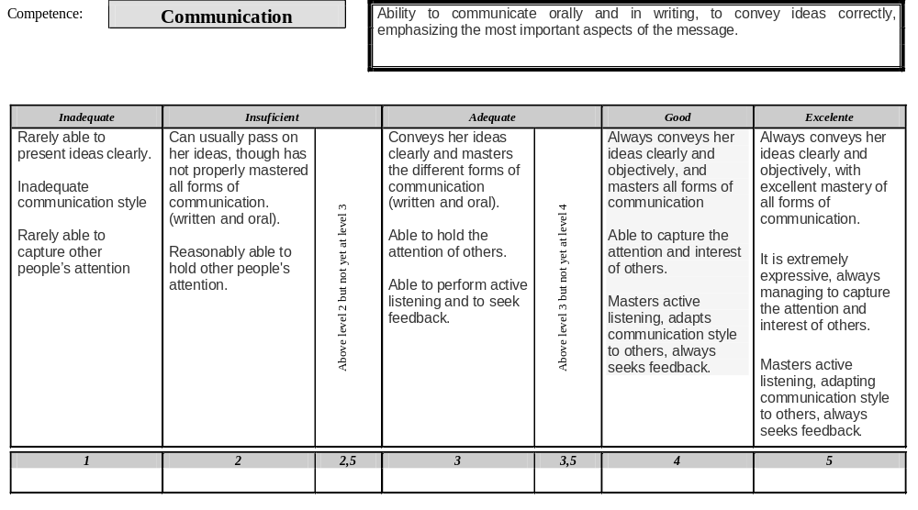

Slide 13
Pros and Cons of the attributes approach
PROS | CONS
Easy to develop | Highly subjective
Most traits are useful to evaluate people in different jobs cross the organization | Validity issues – Difficulties linking competences to performance
 | Does not offer employees useful development guidelines

Slide 14
Evaluating results
Focuses on managing performance by establishing objective, measurable performance targets employees/units should achieve in a given period of time

Slide 15
Pros and Cons of Managing by Objectives
PROS | CONS
Clear link between objectives and company strategy | Performance is often affected by factors out of employees’ control (economic recession; economic boom)
Easy to establish links between organizational and employee outcomes | Individuals may focus only on those aspects of performance that are under evaluation (eg. Focus on quality and not productivity, and vice versa)
Minimizes subjectivity | No attention to how employees behave
Managers and employees usually adhere to MBO
Offers good information to make administrative decisions

Slide 16
What Performance Benchmarks should we use?

Slide 17
Comparing performance between employees
Some organizations choose to evaluate employee performance by adopting a comparative approach
    Common methods
    Simple Raking - Employees are ranked from highest performer to poorest performer within their units
    Forced distributions – Employees are ranked from highest to lowest performer and grouped into predetermined performance categories that integrate a given percentage of workers (eg. Top 10% are considered excellent; 11%-30% Good; 31%-50% Satisfactory; 51%-90% poor; 91%+ not acceptable)

Slide 18
Pros and Cons of the Comparative Approach
PROS | CONS
It is an effective tool for differentiating employees amongst themselves | Does not relate performance to objective employee outcomes
Eliminates problems of central tendency, kindness and strictness | Does not relate performance appraisal to company strategy
Useful to make decisions about promotion or pay raises | Prone to suffer from “office politics”

Slide 19
Sources of Information

Slide 20

Sources of Performance Information
Managers
Customers
Peers
Subordinates
Self

Slide 21
Managers
    Are the most used and the obvious source of information.
Useful for
    Knowledge of workers’ performance and job requirements
    Stand to gain from employees’ performance
    Supervisor feedback is important to improve performance and employee development
    Supervisor feedback may be biased againts/in favor of certain employees
    Proximity with ratees may inhibit supervisors from making negative remarks about employees’ performance
    Making administrative decisions (pay; promotion, termination)
    Employee development (transfer; training, etc.)

Slide 22
Peers
    Are an good source of information, particularly as a complement to information gathered from other sources
Useful for
    Knowledge of workers’ performance and job requirements
    Bring a different perspective to that of manager’s
    Peer feedback may be affected by friendship (inflating good performance) and competition
    Employee development decisions only (transfer; training, etc.)

Slide 23
Subordinates
    Are a good source of information to evaluate managers
Useful for
    Their performance is, to an extent, the result of manager’s ability to motivate and shape attitudes and behaviors
    Stand to gain from good management
    Their feedback may be affected by their subbordinate position (tendency to express positive evaluations)
    Employee development decisions only (transfer; training, etc.)

Slide 24
Self
    For obvious reasons are usually never the only source of information
Useful for
    Knowledge of one’s needs in terms of development
    Tendency toward inflated assessments
    tendency to attribute poor performance to external sources
    Employee development decisions only (transfer; training, etc.)

Slide 25
Costumers
    With the growth of the service sector customers are an increasingly important source of employee performance
Useful for
    Are the recipients of employee’s attitudes and behavior
    Their opinion of service quality is key to company performance
    It’s expensive to get their view of employee performance
    In certain circumstances it may be difficult to link their opinions to specific employees
    Employee development decisions (transfer; training, etc.)

Slide 26
360-degree evaluation
Useful for
    Provides a 360-degree review of employee’s performance
    It’s a powerful monitoring tool of changes in the perceptions of others’ about particular employee’s performance
    People are not always honest in their feedback (trust issues)
    It’s expensive to gather all the information required
    Time/bureaucracy
    Employee development decisions (transfer; training, etc.)
    Very rarely is 360º used for administrative purposes (6% according to e-reward survey 2007)

Slide 27
Rater errors
Similar to me (issues of gender, ethnicity, race)
Distributional errors (leniency; strictness; central tendency)
Halo and horns

Slide 28

Performance Feedback – Spot the Mistakes

Slide 29
Guidelines to improve performance feedback
Feedback should be given frequently, not once a year.
Create the right context for the discussion
  Schedule a time
  Allow no interruptions.
Ask employees to rate their performance before the session (helps them make a critical assessment of their performance).
State the purpose of the discussion (warm up)
  Advantages of performance appraisal
  What is being appraised and what information is being used
Encourage the subordinate to participate in the session
  Ask employees how they think they did
  Use open-ended questions.

Slide 30
Guidelines to improve performance feedback
Present your assessment
  Be clear
  Focus feedback on behavior or results, not on the person
  Praise effective performance
  Point negative aspects without over criticizing
  Focus on solving problems.
Ask for employee’s opinion of your assessment (feedback should not be a monologue and raters aren’t always right!)
Agree to specific goals and set a date to review progress (feedback is only useful if it contributes to improving employee performance)

Slide 31
Consequences of performance appraisal
High Ability
Underutilizers
Offer career counseling
Assess reasons for low motivation
Consider transfer, job rotation or job enlargement
Solid Performers
Rewards (salary increase; promotion)
Development opportunities (eg., training)
Retention
Low Motivation
High
Motivation
Deadwood
Consider negative outcomes: demotion or termination
Misdirected effort
Consider development opportunities (training, coaching, mentoring)
Transfer, new assignments
Low ability
Source: Adapted from London, 1997

Slide 32
References
Byrne, Z. S., Pitts, V. E., Wilson, C. M., & Steiner, Z. J. (2012). Trusting the fair supervisor: the role of supervisory support in performance appraisals. Human Resource Management Journal, 22(2), 129-147.
Drexler, J. A., Beehr, T. A., & Stetz, T. A. (2001). Peer appraisals: Differentiation of individual performance on group tasks. Human Resource Management, 40(4), 333-345.
Erdogan, B. (2003). Antecedents and consequences of justice perceptions in performance appraisals. Human Resource Management Review, 12(4), 555-578.
Grint, K. (1993). What's wrong with performance appraisals? A critique and a suggestion. Human Resource Management Journal, 3(3), 61-77.

